Slide 1
Capstone Project - The Battle of Neighborhoods (Week 2)
Assessing Hotel Investors in Istanbul
Ahmad M Dehcheshmeh
09.09.2019

Slide 2
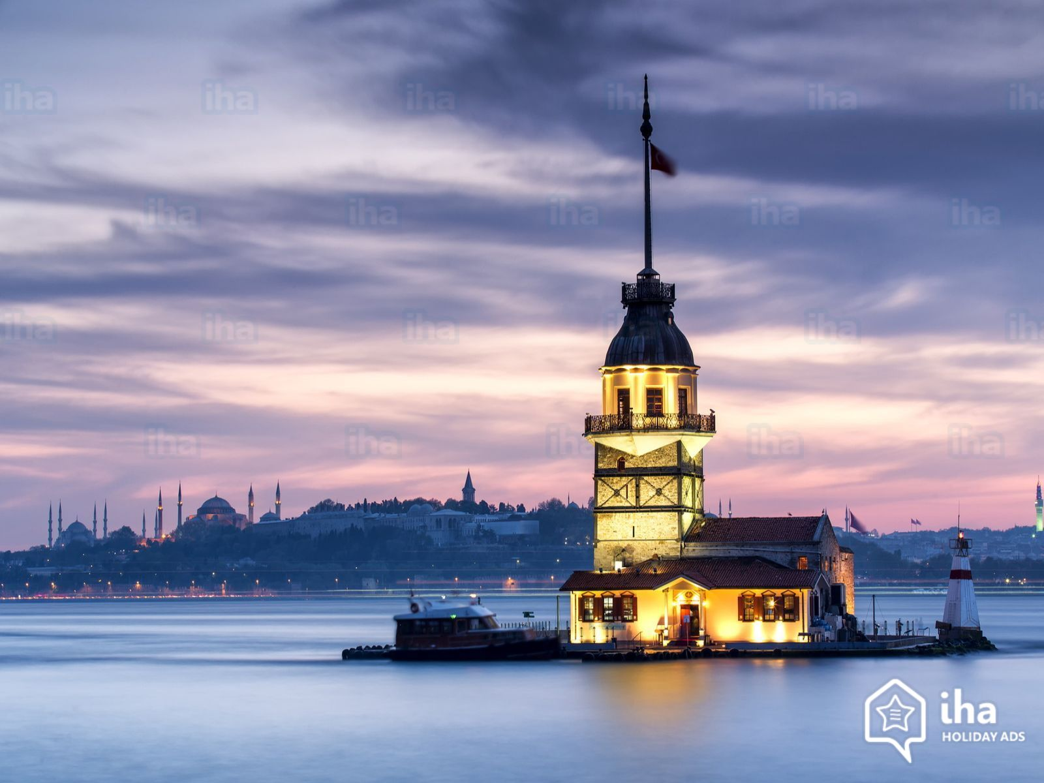
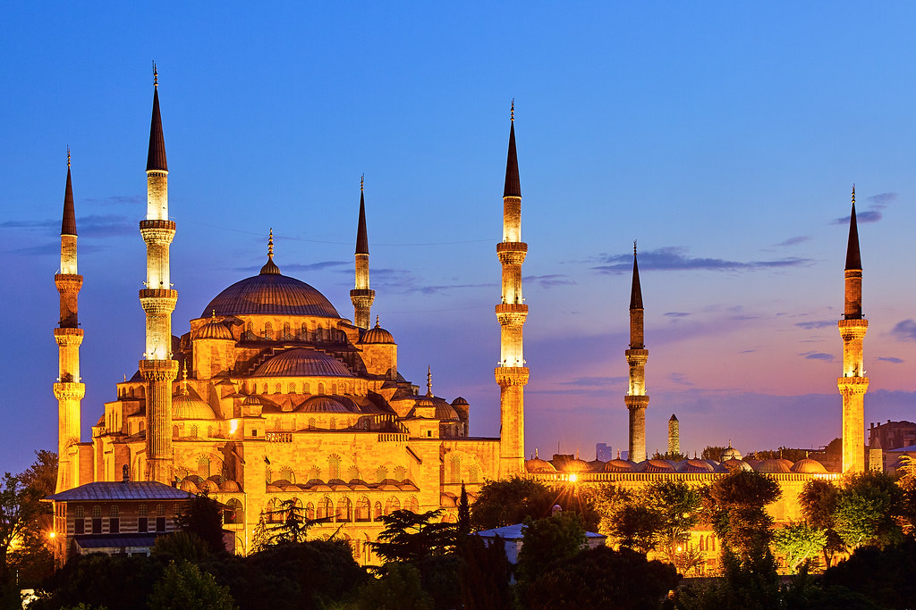
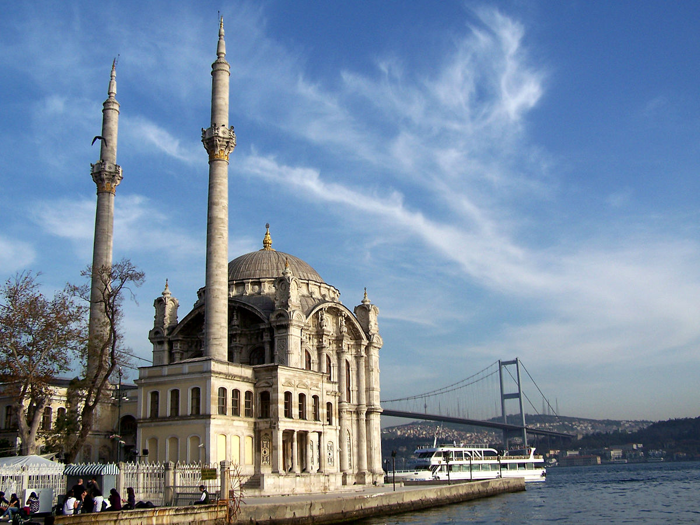
Have you been in Istanbul?
Notes:
Istanbul is the most well-known city in Turkey and one of the great metropolises, straddling both Europe and Asia where economy and culture from all over the world meets

Slide 3
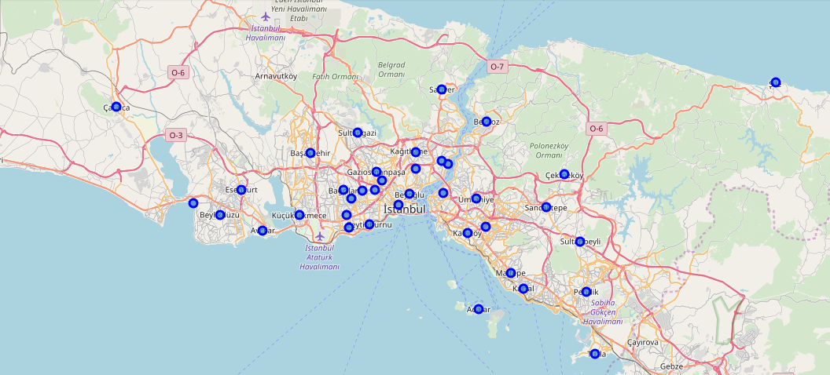
Borough in Istanbul
Notes:
Here you can see different boroughs in Istanbul that was created using folium library in python and letter on by using geopy library the coordination of each boroughs were calculated and then mapped as you can see.

Slide 4
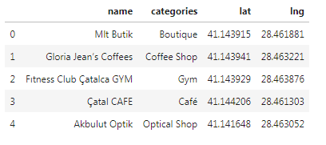
Venues of Çatalca
Notes:
Let’s assume we would like to open hotel in Çatalca in Istanbul. Foursqure make it possible for us to find out the top wanted or also all the venues in that specific borough. In this case Çatalca, 84 venues were returned by Foursquare. In theses 84 venues you can see coffee shops, gym or many more facilities and the investors could make a decision based on their plans. If there enough hotels in that borough or not are they museum or any relative facilities.

Slide 5
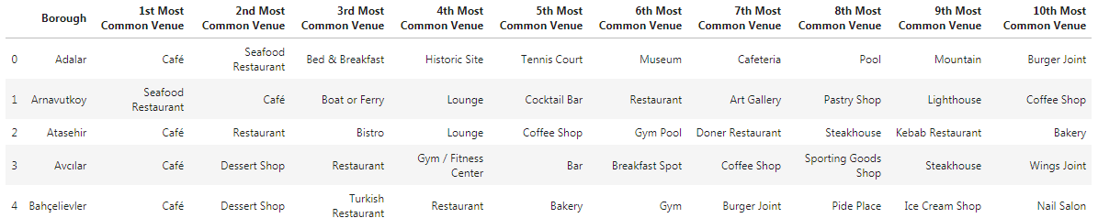
The top Ten venues in each borough in Istanbul
Notes:
If the investors have no idea about the boroughs with a help of Foursquare they can analysis the best borough and the facilities in them and then make a decision about their future plan.

Slide 6
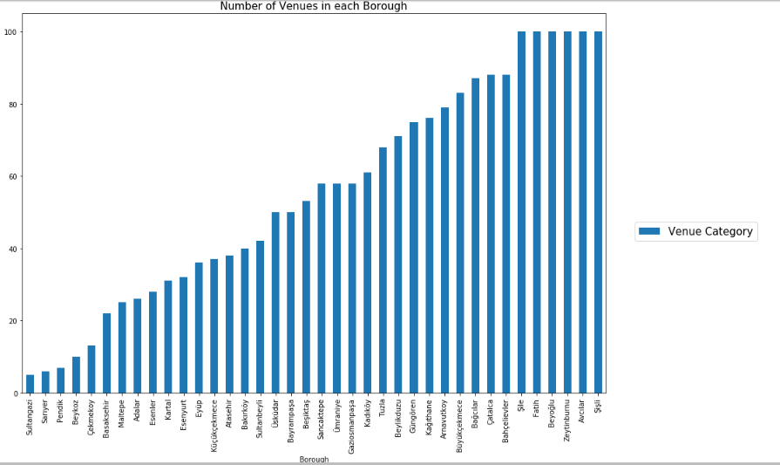
Number of the Venues in Each Brough
Notes:
In this diagram we can see the number of venues in each borough it can give us a better understanding about the facilities in the boroughs, as we can see Şişli, Şile hreave more than 100 venues in these borough, therefore the investors can consider these places first for their investers.

Slide 7
As more tourist are coming back to Istanbul lot of stakeholders see this as an investment in hotel business, in this research different boroughs of Istanbul were analyzed for hotel investors based on the number of facilities that each borough can offer and let investors select where to invest.
Avcılar
Şişli
Şile
Fatih
Beyoğlu
Notes:
These boroughs have the highest number of venues compered to other boroughs in Istanbul, therefore the investor can decide if they would like to invest in once of these boroughs.

